Slide 1






PocketPaw Co: Operations
YOUR PET IN YOUR POCKET

Slide 2
Our team
David Pérez
Federico
Falcone
Gullem
Escriba
Oriol Soler
CEO
CFO
CEO
GENERAL MANAGER
Data Science Engineer
Computer Engineer
Data Science Engineer
Audiovisual Engineer

Slide 3
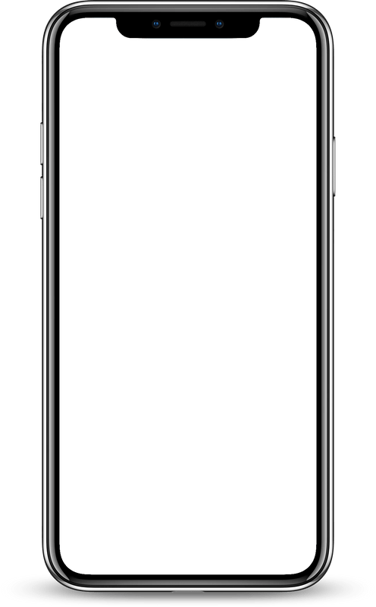














PocketPaw App
Activity
Tracking
Pet profile
Pet tracking results:
HOME PAGE:
Select a location to obtain more information about it.
Here we can see the main features of the app:
Activity tracking
Pet Profile
Reminders and schedulers
GPS tracking
Medical records
Social community
Reminders and schedules
GPS tracking
PRO
PET TRACKING MAP:
Medical records
Social community
An interactive map that tracks the current location of each of our registered pets to know at real time where are they.
List of tracked pets:
List of tracked pets:
PRO
PRO

Slide 4





PocketPaw Co: Development Stages
WEB CREATION
COMPANY CREATION
APP DEVELOPMENT
TESTING THE ENVIRONMENT
LAUNCHMENT AND PROMOTION
PRODUCT CREATION
1 Year
STAGE 0: COMPANY CRETION (MONTH 1)
STAGE 1: APP, WEB AND PRODUCT DEVELOPMENT (MONTHS 2-5)
STAGE 2: TESTING THE ENVIRONMENT (MONTHS 6-8)
STAGE 3: LAUNCHMENT AND PROMOTION (MONTHS 9-12)
The first step is creating the company after that we need to define the idea while we outsource a external market study.
After the development of the Web, App and the Product, and making several tests and corrections, we need to test the whole environment.
Social Media promotion and first releases of BETA versions of the product to get feedback and do the final corrections.
We will create three parallel development teams, one for each feature of the environment. The Web Creation will be outsourced.

Slide 5


Stage 0:
Company Creation
Legend
Outsourcing
PocketPaw Co
Background processes
Month 1
Task
Week 1
Week 2
Week 3
Week 4
Company Creation
Documentation
Brainstorming
Defining the idea
Market Study
Creating the teams
Funding

Slide 6
Legend
Marketing Team
Stage 1: PocketPaw Development
Outsourcing
Product Dev Team
APP Dev Team
Web Dev Team
Month 2
Month 3
Month 4
Month 5
Task
5
6
7
8
9
10
11
12
13
14
15
16
17
18
19
20
APP: Design and mockup
APP: Software programming
Application
APP: UI programming
APP: Combine software + UI
APP: Testing
APP: Social Media Forum
Web: Search Web developers
Web
Web: Design and mockup
Web: Creation
Web: Testing
Product: Design
Product: Prototyping
Product
Product: Providers
Product: Testing
Product: Distributors KIWOKO

Slide 7
Stage 2:
Testing the environment
Legend
Outsourcing
General Team
Month 6
Month 7
Month 8
Task
21
22
23
24
25
26
27
28
29
30
31
32
Testing web services
Web corrections
Interaction APP-Web
SEO Web
Testing GPS features
Final corrections

Slide 8
Stage 3:
Launchment and promotion
Legend
Marketing Team
General Team
Month 9
Month 10
Month 11
Month 12
Task
33
34
35
36
37
38
39
40
41
42
43
44
45
46
47
48
Vet collaboration
KIWOKO promotion
Social media campaign
Release BETA
Final corrections
Final release

Slide 9

After Launch
MAIN MOTIVATION TO BET ON PRO PLAN
Although we already generate benefits with the advertisement, to develop and reinvest in innovating, our main goal is to motivate 40% of our clients to bet on Pro Plan in the first year. This objective is hard, but we have developed the called PocketCoin Plan.
QUALITY SUPERVISION
Quality supervision includes an interest in controlling the quality of both services and products by practicing monitoring throughout their entire lifecycle.

Slide 10



Quality supervision plan
COSTANT MAINTENANCE AND MONITORING
This involves regularly checking for performance issues, fixing bugs, updating security measures, and making other improvements as needed. By keeping everything well-maintained, we can ensure that it continues to work well for users and enhances the user experience.
CUSTOMER CARE SERVICE
We provide support to users who have questions or issues, and working to resolve any problems that arise. Good customer service can help to build user trust and loyalty. The service is offered via livechat or by phone.
USER FEEDBACK
We care about user's opinion: we regularly collect and analyze user feedback to understand how users are using the app and identify areas for improvement.
USER ENGAGEMENT
We aim to engage with users through app updates, social media, and other channels to keep them informed about new features and improvements, and to build a loyal user base.

Slide 11


Risks identification
 | Probability | Impact | Mitigation
Services interruption | Low | Unavailable functionalities Loss of confidence | Maintenance and monitoring Redundancy/disaster recovery Services available offline
Component shortage | Low | Production delays | Diversifying suppliers Inventory buffer Market monitoring
Data security threats | Very low | Security concerns | Incident response plan Data encryption Regular data backup
Delivery disruptions | Medium | Shipping delays | Communication with customer Building strong partnerships
Legal problems with Data regularization | Low | Stop our app functionality until the matter is solved | Contract expert lawyers Adapt privacy policy

Slide 12
Risks identification
 | Probability | Impact | Mitigation
No funding found | Medium | Unable to start the company | Make a more aggresive financial promotion campaign Ask for a public loan More investment from the founders
Collaboration disruption | Low | Disrpution of one of our promotion vias. May cause less visibility of the brand. | Look for new possible colaborators Temporary invest more on the other promotion vias
Low Pro Version Success | Medium | Delaying or preventing the company from the financial objectives. | Increase persuasion campagin through ads and discounts Making some collaborations only about the Pro version

Slide 13

Thanks for your participation!
EMAIL | WEBSITE | SOCIALS
info@pocketpaw.com | www.pocketpaw.com | @pocketpaw

